Slide 1
HOW TO GO AHEAD WITH SEX EDUCATION AT HOME
There is no specific age to educate the child about sex and sexuality. Earlier you start, child will be comfortable at each stage of development.
Personal hygiene and cleanliness.
Private and public
Good touch/bad touch
Pre-pubertal change
Onset of puberty
Menstruation/nocturnal ejaculation/masturbation

Slide 4
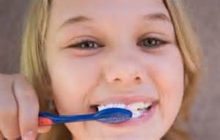
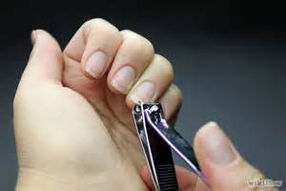

Slide 5
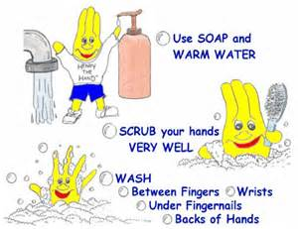
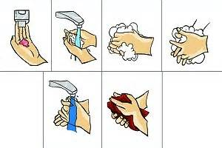

Slide 6
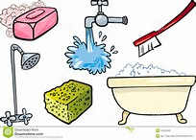

Slide 7
Keep the body clean
Understand & follow the command ‘NO’
Use waste paper basket
Keep home tidy
Help in daily chores
Dress tidy
Mannerism & discipline
Learn through consequences
All the above helps to build sense of responsibility & belongingness/ownership

Slide 8
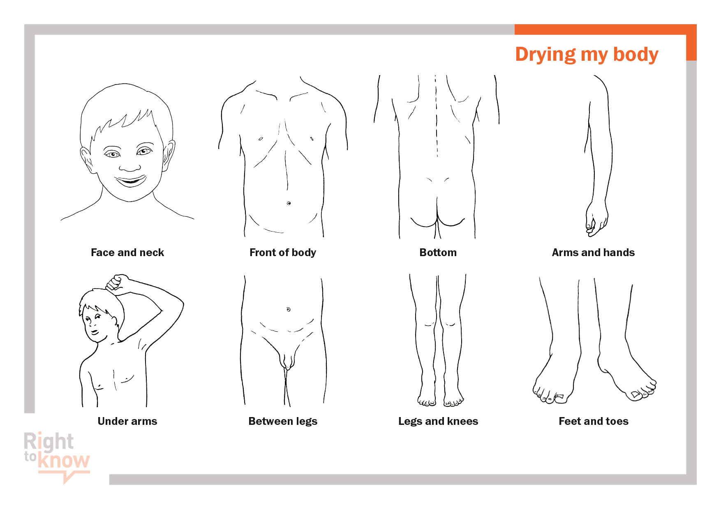

Slide 9
Our children need to understand about privacy. It helps to discuss privacy by talking about the colours that can be used to signify various stages of privacy – ranging from private to public.
Think about the colours of the traffic signals – green, red and yellow.
You may use coloured cards as you talk about each concept.

Slide 10
Ensure your child understands the traffic signals concept before you start.
Red stands for things that are private
Yellow stands for
‘Be Careful’.
Green stands for things that are public & protected.

Slide 11
• Anyone can go there.
• There is usually no doorbell and you would not need to knock or ask permission to enter. Banks, post office, library, restaurant, place of worship etc.
• Some rooms in our homes are public. There is not usually a door on these rooms except for the main entrance where there is a doorbell.
• There may be strangers in these places.

Slide 12
These are found in public places.
A changing room in the store.
In gatherings, at parties & picnics when we are with mixed crowd.
At railway station/bus-station/market/ parks/fair/mall/multiplex etc.
We need to be careful when we use these places.
BE CAREFUL EVERYTIME WHEN STRANGER IS AROUND

Slide 13
There are very few private places in our lives. Usually they are just found in our homes- our bedroom and our bathroom.
We need to do things to make our private areas very private. We would shut the door and close the curtains.
If someone wants to enter another person’s
private places, they must knock on the door and wait to be invited in.
When we are in our private places, we can do anything we want

Slide 14
DISCOURAGE
Dressing and undressing in public/with door kept open.
Running naked between bathroom and bedroom.
Leaving the door open while using the toilet
Changing into/out of swimwear at the pool/beach
Pull down wet cloth/pant in a public room at home
Parents/grandparents not maintaining privacy.

Slide 15
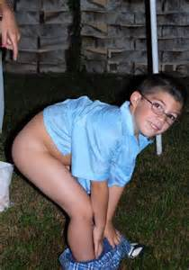
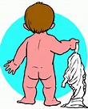
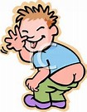

Slide 16
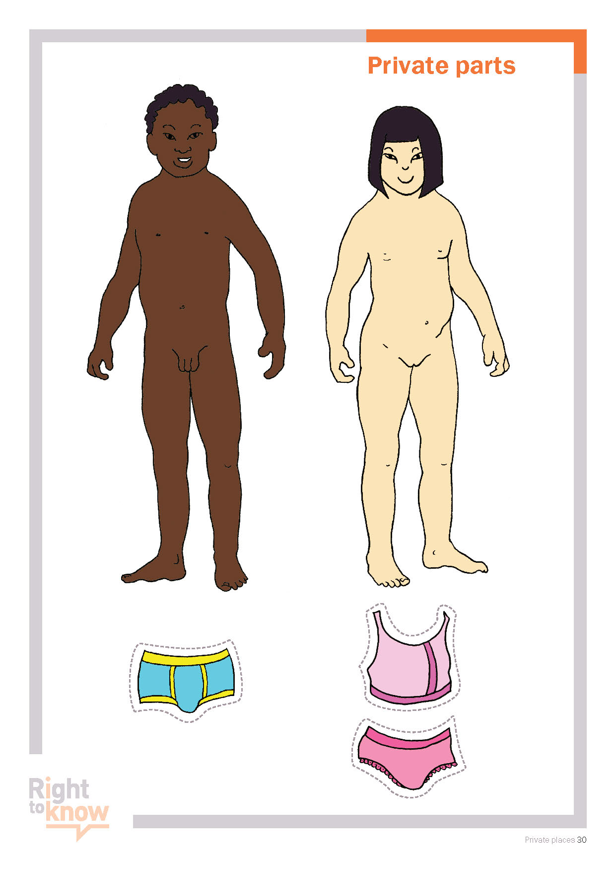

Slide 17
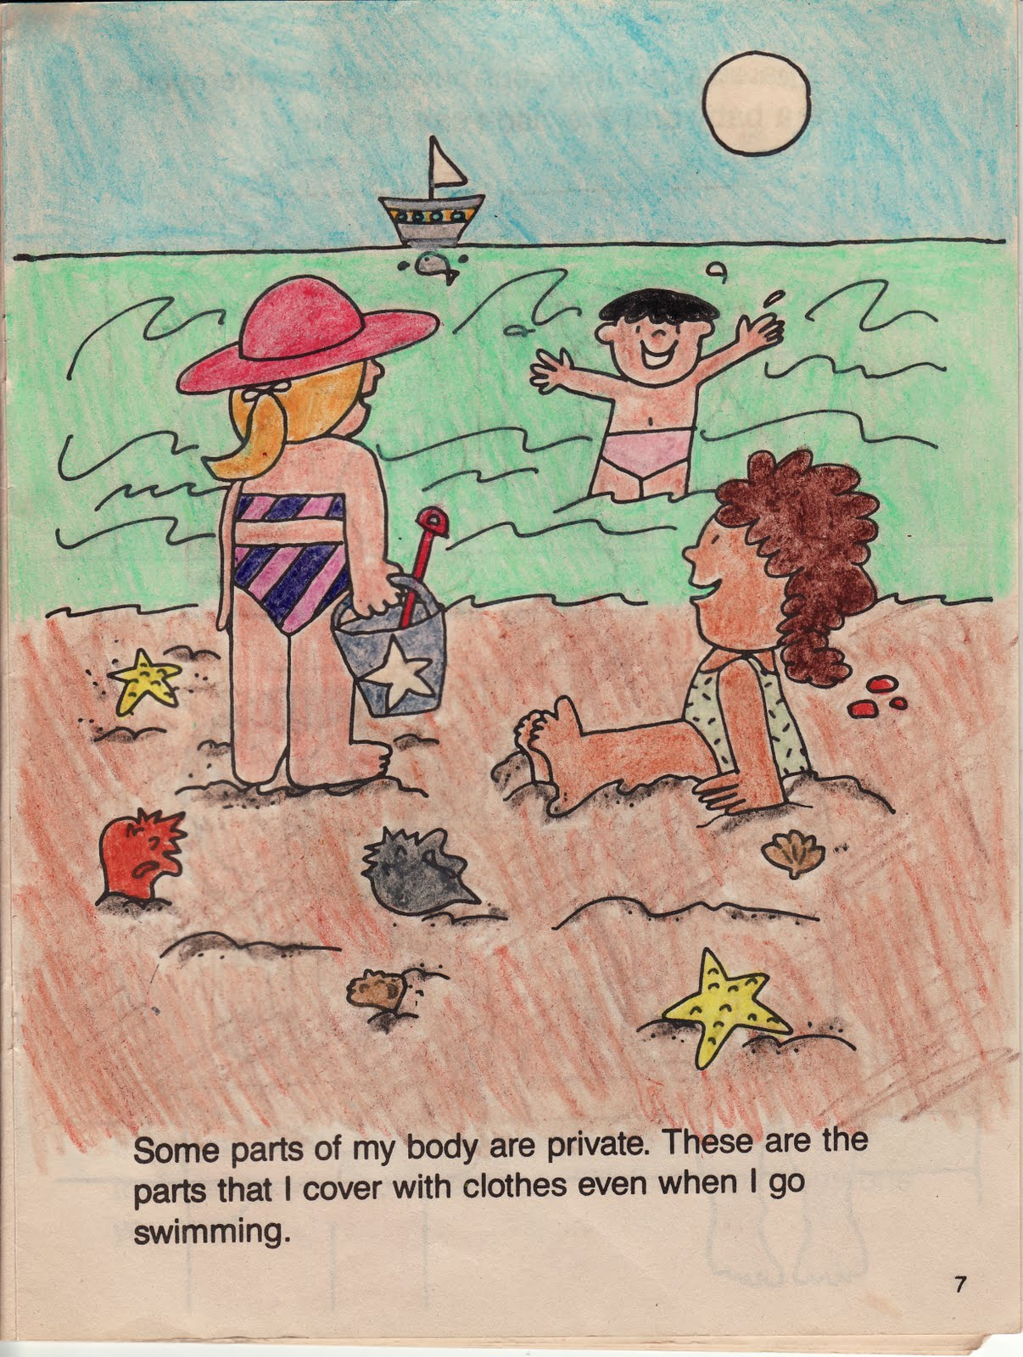

Slide 18
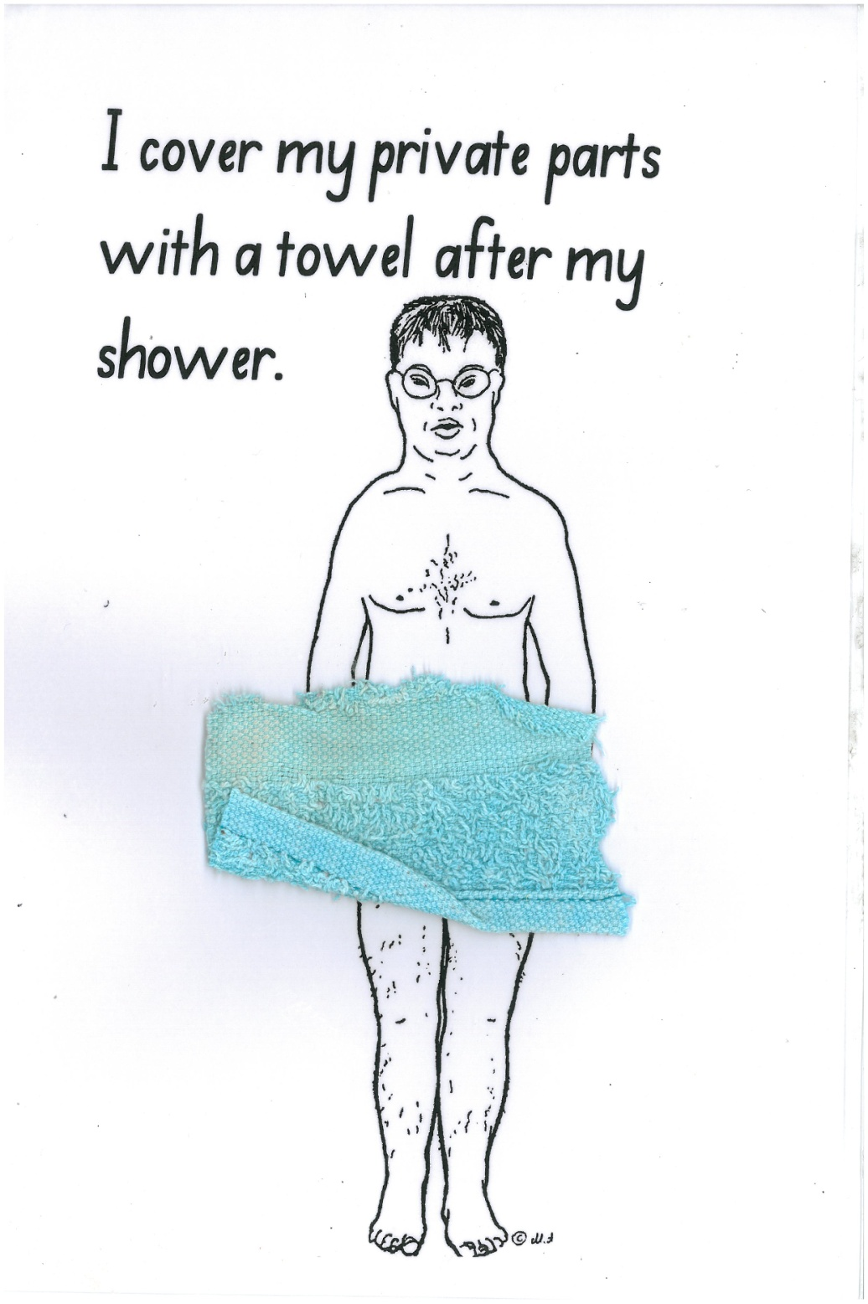
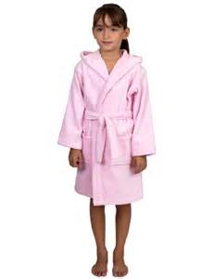
I cover my body wearing a bathrobe after my shower.

Slide 19
Help your child to bathe but don’t take bath with your child. It’s fun to play together with water while children are bathing . Don’t let your fun get buried…have fun but follow the swim suit rule.
Don’t change cloths in front/in presence of your child.
Close the door of your room while changing.
Don’t keep the doors open while using the bathroom/toilet.

Slide 20
Explaining the pre-pubertal changes
Now we are focusing on the reproductive system.
Collect your photos right from your childhood & arrange them stepwise, this would facilitate to talk about the physical changes.

Slide 21
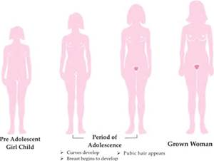
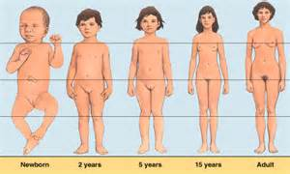
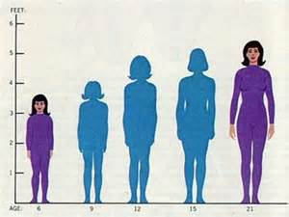
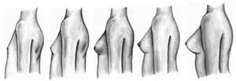
PRE-PUBRTY PUBERTY ADULT

Slide 22
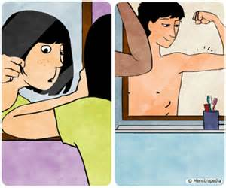

Slide 23
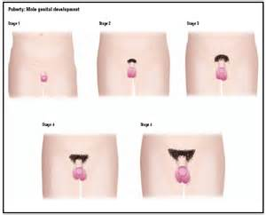
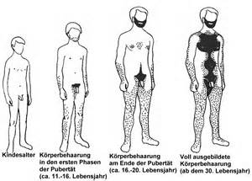
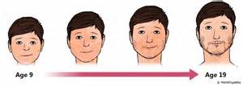
PRE-PUBRTY PUBERTY ADULT

Slide 24
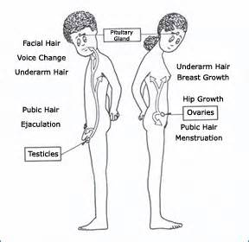

Slide 25
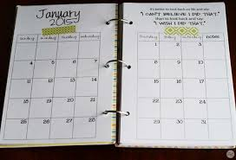
MENSTRUATION- TEACHING ABOUT THE CYCLE

Slide 26
HYGEINE DURING MENSTRUATION

Slide 27
Choose the method of sanitation that suits the best & then stick to that.
Change regularly. Napkin once every 6 hours & tampon every 2 hours. Be very careful if you have selected to use tampon. If not done it can lead to conditions like urinary tract infection, vaginal infections and skin rashes..
Wash or wipe off regularly.
No need to use soap or vaginal hygiene products.

Slide 28
5. Use the right washing technique:
Always wash or clean the area in a motion that is from the vagina to the anus.
6. Discard your used sanitary product properly
They are capable of spreading infections. Wash your hands well after you discard your used napkin .
7. Beware of a pad rash
Stay dry during your periods. Apply an antiseptic ointment, after a bath and before bed

Slide 29
8. Use only one method of sanitation at a time
Even when you have heavy flow do not use either (i) two sanitary pads, (ii) a tampon and sanitary pad (iii) a sanitary pad along with a piece of cloth. This can lead to rashes and infections. Using a piece of cloth is not a good idea
9. Have a bath regularly
Having a bath is the best thing you can do for your body during your periods. It also helps relieve menstrual cramps, backaches, helps improve your mood.

Slide 30
10.Be ready with on-the-go stuff during your periods.
When you have your periods it is important to be ready. It is important to have extra sanitary pads or tampons properly stored in a clean pouch or paper bag, a soft towel, some paper tissues or towels, hand sanitizer, a healthy snack, bottle of drinking water, a tube of antiseptic medication.
(if you are using one).

Slide 31
Masturbation is common throughout .Children masturbate from an early age. The behaviour usually increases during adolescence.
Masturbation is a natural thing for children and adults to do.
Masturbation may also be a symptom of non-sexual problems such as frustration, boredom, or loneliness.
Masturbation may seem excessive because it occurs in inappropriate places. This may happen because an individual has no appropriate places to masturbate or because he or she hasn’t been taught where it is appropriate to masturbate.

Slide 32
Excessive masturbation may occur:
When there are personal emotional problems
When there is an irritation such as a skin rash
When clothing is too tight
When there is an infection
When a physical disability affects sensitivity to pain or pleasure

Slide 33
when an individual has a general tendency to engage in obsessive, repetitive, and/or self-abusive behaviour
when an individual has hyposensitivity to touch. This individual may need to masturbate longer or more forcefully just to get sufficient sensations.
As an attention-getting behaviour
when an individual has been sexually abused

Slide 34
Masturbation cannot be ignored:
when it is done in a public place
when it is done in a private place (such as a bedroom), but when other people are around
when it interferes with daily living (the individual no longer finds time for family or friends, other interests, schoolwork, or their job)
when an individual is rubbing so hard or so often that there is soreness or bleeding

Slide 35
Individuals may need to learn the following things:
Masturbation should be done in a private place at home, such as a bedroom or a bathroom with the door closed and the curtains drawn.
Masturbation is a private behaviour that should be done alone.
Clean up after masturbating – this includes wiping off the genitals, wiping up semen (for males), and washing hands.
Masturbation should not be discussed in public places with family, friends, or strangers.
Masturbation can be discussed in private with a doctor, nurse, parent, or other appropriate person.

Slide 36
Dealing with Inappropriate Masturbation
Be clear about your rules.
Respond to inappropriate masturbation in a calm, non-judgmental manner. Use clear language. For example, “It’s not okay to masturbate here. You can do that in the bathroom.”
If possible, coordinate the messages given at home and at school or work, so that you and all school or work staff are giving consistent messages.
Look for possible causes if the inappropriate behaviour persists.

Slide 37
Behavior modification techniques can be applied to inappropriate masturbation.
Possible techniques include:
Encourage other, incompatible behaviors – your child won’t be able to masturbate if their hands are busy doing something else.
Reward appropriate behavior or the absence of inappropriate behavior.
Extinguish attention-getting behavior by ignoring it or calmly redirecting your child. This may be difficult – masturbation is a very private behavior, and seeing it in public may cause feelings such as anger, fear, or disgust.
www.imwidu.blogspot.in
BEHAVIOUR MODIFICATION TECHNIQUES

